Slide 1
Beer Me!
Christopher Henderson
Seth Plunkett

Slide 2
Project Idea
We have repurposed an old refrigerator to be used as a “kegerator”, essentially a cooler for storing a keg of beer. The keg sits on a platform that has been outfitted with 2 weight sensors. The two sensors estimate the weight, which is compared to the full and empty weight of the keg, and returns the approximate amount of beer remaining in the keg. Additionally, a temperature sensor tells us the temperature of our beer and warns us if the beer has gone above or below a certain value.
Our program implements an Arduino Twitter library, specifically, a twitter.cpp and twitter.h file, which contain post and getStatus functions. The post function has been slightly modified to add different parameters and a larger message size from the stock “Hello Arduino!” message.
The main .ino file incorporates the base code of the “simple Tweet” example. This provides the basic capacity to tweet specified information to a twitter account with a certain token. We have added code to read and translate sensor information into usable values that are formatted and sent as a message.
Importantly, we needed to designate a “trigger event” that would cause the program to retweet. We chose to use a fork which initiates a retweet every 15 minutes. The trigger event can easily be changed.

Slide 3
Project Plan
L0
Ensure that Arduino devices can post on twitter
Produce wiring requirements for weight sensor, design and overall plan.
L1
Initial product with input of temp and weight sensors
Comprise those elements into twitter format and post onto twitter
Design a process that the program that the Arduino can accept the input from the sensors
Design additional hardware that is needed to produce signal into the Arduino
L2
Perform a search function on twitter for specific # and extract possible specific replies
Add button sensor to determine if the refrigerator is open
Add LCD screen to the front of the fridge with current information
L3
Implement auto reply on twitter and integrate multiple triggering events
Add camera functionality to be triggered when the door is opened

Slide 4
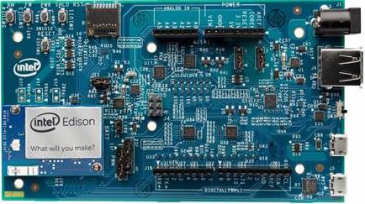




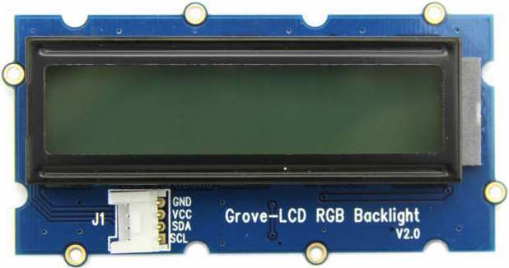

Beer Me Design
Internet
Web Camera
Temperature Sensor
Twitter
Button Sensor
Weight Sensor
LCD Screen

Slide 5
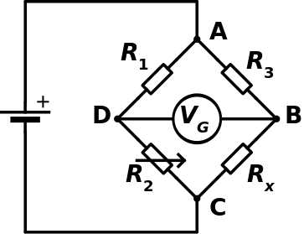
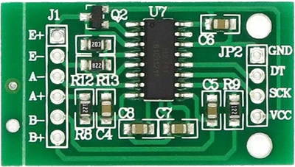
Weight sensor design

Slide 6
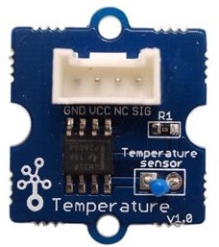
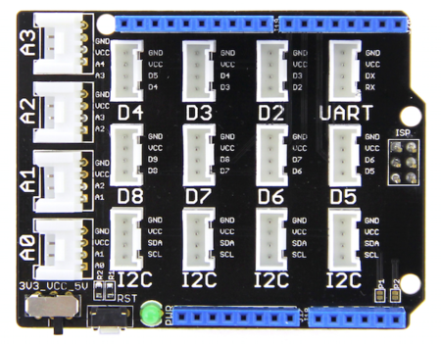
Temperature Sensor

Slide 7
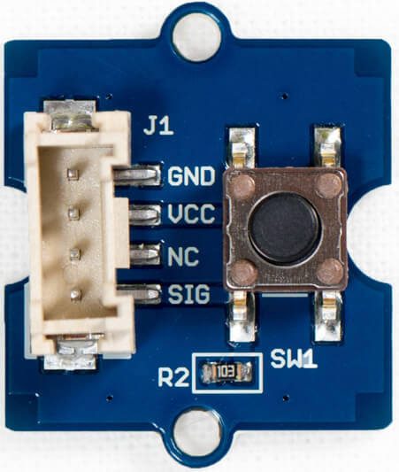
Future Sensors implementation

Slide 8
Program process diagram
Beer Me App
#BeerMeApp!
Internet
Twitter
All users - “#BeerMeApp!”
JSON

Slide 9
Program process diagram
Beer Me App
Internet
Twitter
Temp
Weight
Accounts “#BeerMeApp!”
WebCam

Slide 10
Demonstration
https://twitter.com/search?q=%23BeerMeApp!&src=typd

Slide 11

Questions

